Slide 1
RECOMMENDATION SYSTEMS (MR22-1CS0158)
COURSE STRUCTURE
UNIT-1 :
Recommender Systems Function, Recommendation Techniques, Recommender Systems as a Multi-Disciplinary Field, Challenges.
UNIT-2:
Basic Components of Content –Based Systems, Preprocessing and Feature Extraction, Learning User Profiles and Filtering, Nearest Neighbor Classification.
UNIT-3:
User-Based collaborative filtering, Similarity Function Variants, Variants of the Prediction Function, Item-Based Collaborative filtering, Comparing User-Based and Item-Based Methods, Strengths and Weaknesses of Neighborhood-Based Methods.
UNIT-4:
Rule-Based Collaborative Filtering, Association Rules, Naive Bayes Collaborative Filtering, Neural Network, Singular Value Decomposition, Stochastic Gradient Descent, Regularization.
UNIT-5:
General Goals of Evaluation Design: Accuracy, Coverage, Confidence and Trust, Novelty, Serendipity, Diversity, Scalability, Segmenting the Ratings for Training and Testing, Accuracy Metrics in Offline Evaluation.

Slide 2
UNIT-I
Recommender Systems Function
Recommendation Techniques
Recommender Systems as a Multi-Disciplinary Field
Challenges

Slide 3
1. Recommender Systems Function
Data Collection
Data Processing and Analysis
Prediction of Preferences
Recommendation Generation
Personalization
Filtering
Adaptation
Presentation
2. Recommendation Techniques
Content-Based Filtering (CBF)
Collaborative Filtering
Hybrid Filtering
3. Recommender Systems as a
Multi-Disciplinary Field
1. Computer Science and Engineering
2. Machine Learning and AI
3. Mathematics and Statistics
4. Information Retrieval (IR)
5. Cognitive Science and Psychology
6. Human-Computer Interaction (HCI)
7. Data Science
8. Economics and Game Theory
9. Ethics and Privacy
10. Marketing and Consumer Behavior
4. Challenges
1. Data Challenges
2. Algorithmic Challenges
3. User-Related Challenges
4. Ethical and Social Challenges
5. Domain-Specific Challenges
6. Evaluation Challenges
7. Scalability and Infrastructure Challenges

Slide 4
Recommendation Engine
A recommendation engine, also called a recommender, is an artificial intelligence (AI) system that suggests items to a user.
Recommendation systems rely on big data analytics and machine learning (ML) algorithms to find patterns in user behavior data and recommend relevant items based on those patterns.
or
A recommendation engine (or recommender system) is a type of software tool or algorithm designed to suggest relevant items or content to users based on their preferences, behavior, or historical data.
It is widely used in industries like e- commerce, entertainment, and social media to personalize user experiences and increase engagement.

Slide 5
Recommendation Engine:
Definition: Refers specifically to the core algorithm or software component responsible for generating recommendations. It is the technical "engine" that processes user data, item data, and interactions to produce personalized suggestions.
Recommendation System:
Definition: Encompasses the entire system that delivers recommendations, including not just the engine but also the interfaces, data pipelines, user experience, and any supporting infrastructure.

Slide 6
Recommendation Phase
Information Collection Phase
Learning Phase
Prediction/
Recommendation Phase

Slide 7
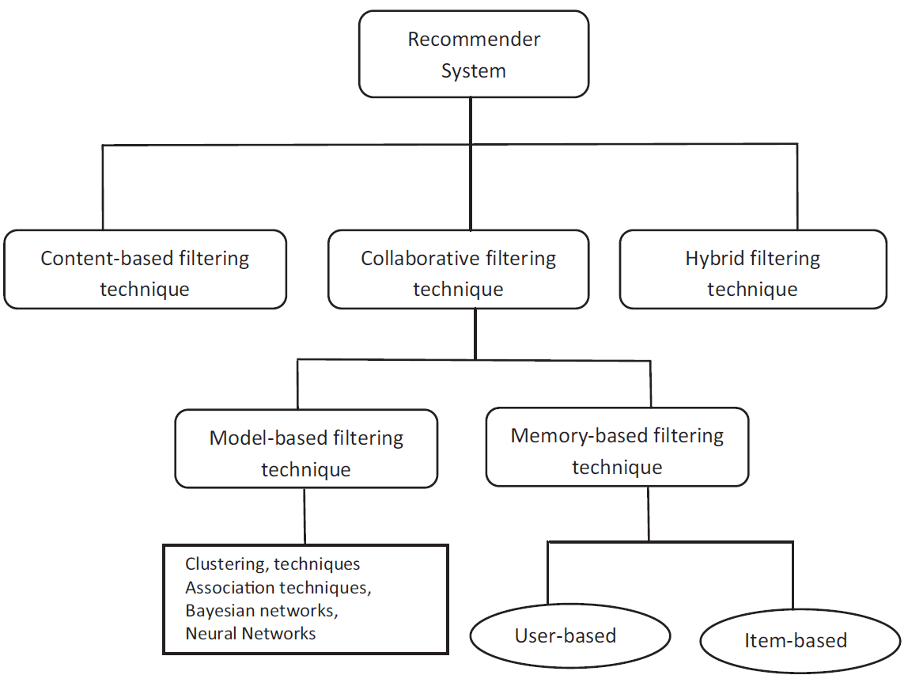
Recommendation Techniques

Slide 8
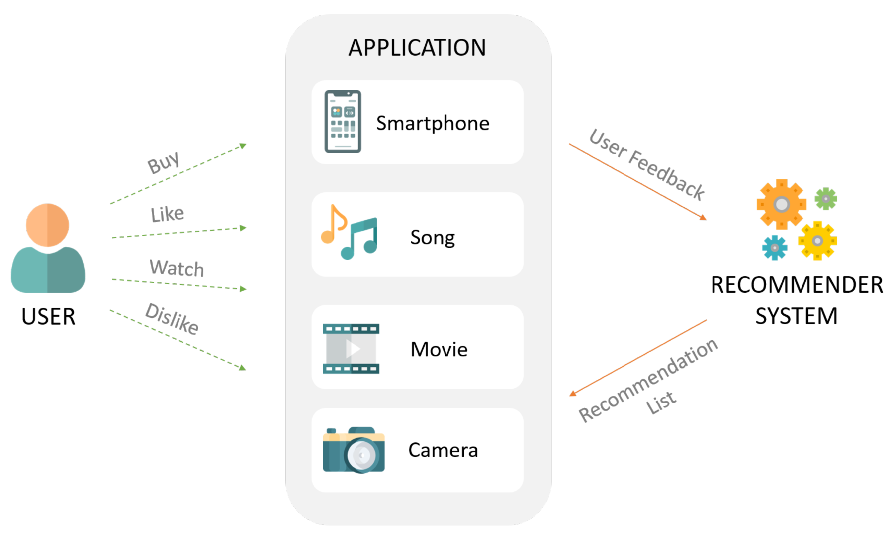
Example for Recommendation System

Slide 9
1. User Interaction:
Users interact with applications by performing various actions -buying products, liking songs, watching movies, and disliking certain content. Each interaction provides valuable feedback, forming the basis of the recommendation process.
2. Application's Role:
The application acts as a channel, gathering feedback from users and providing it to the recommender system. This process helps in categorizing user preferences and behaviors, essential for accurate recommendations.
3. Recommender System's Function:
The recommender system processes the user feedback using sophisticated algorithms. It generates personalized suggestions, ensuring that users receive relevant and engaging content. This continuous loop of feedback and recommendations enhances user satisfaction and engagement.

Slide 10
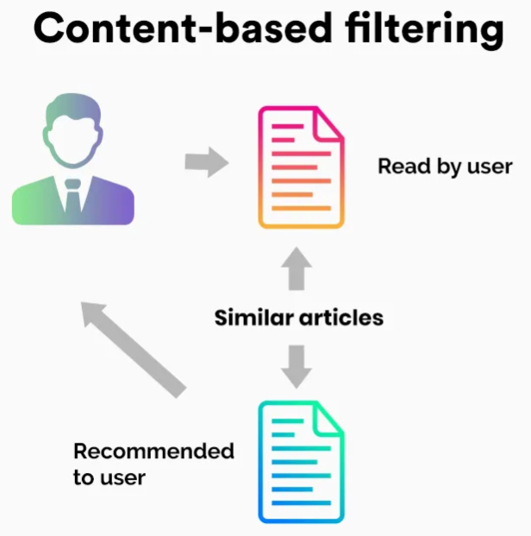
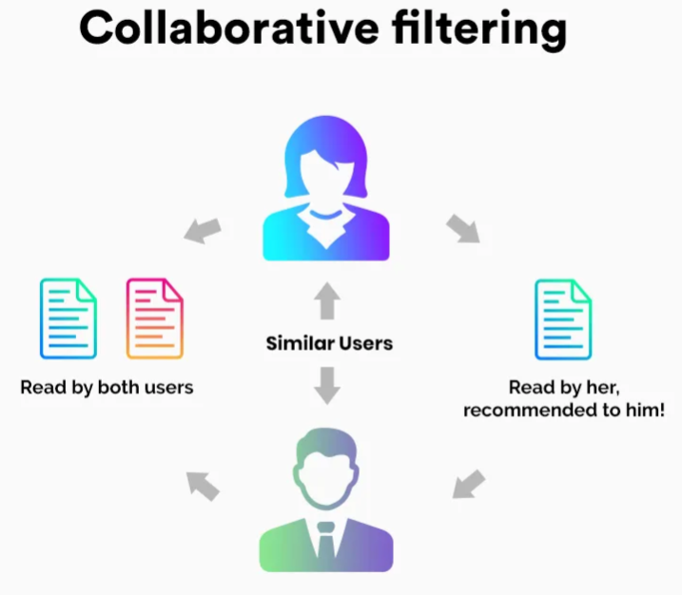
Content-Based Filtering
Recommends items similar to those the user has interacted with or liked in the past.
Example: If you watched a sci-fi movie, it suggests other sci-fi movies based on attributes like genre, actors, or director.
2. Collaborative Filtering
Recommends items based on the preferences and interactions of other users.
User-based Collaborative Filtering: Finds similar users and recommends what those users liked.
Item-based Collaborative Filtering: Finds similar items based on the preferences of users who interacted with them.

Slide 11
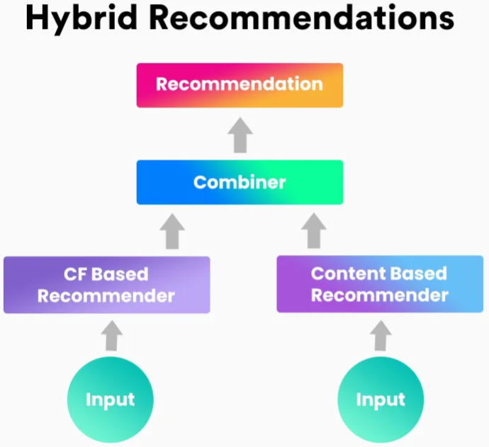
3. Hybrid Systems
Combines content-based and collaborative filtering techniques for more accurate recommendations.
Example: Netflix uses a mix of these approaches to recommend shows and movies.

Slide 12
4. Context-Aware Recommendations
Incorporates contextual information (e.g., location, time, device) into the recommendations.
Example: Recommending coffee shops nearby on a mobile app.
5. Knowledge-Based Systems
Relies on explicit knowledge about the domain and user requirements.
Example: Travel websites that recommend destinations based on user-specified criteria like budget and climate.

Slide 13
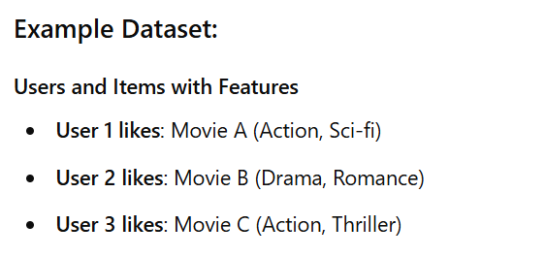
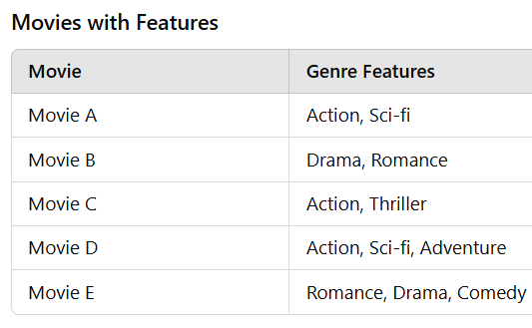
Content-Based Filtering

Slide 14
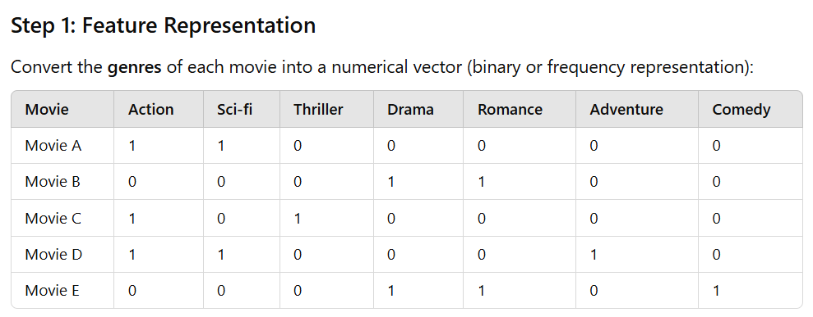
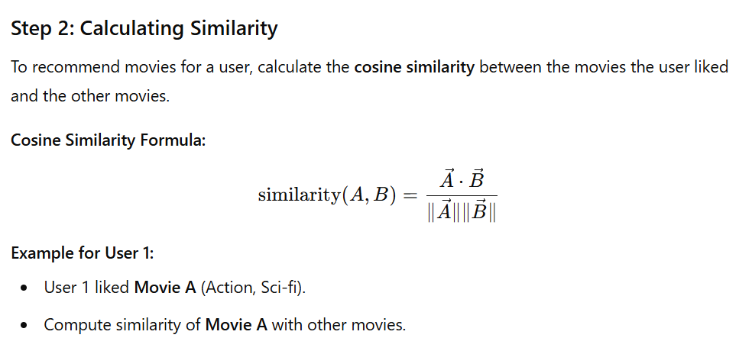

Slide 15
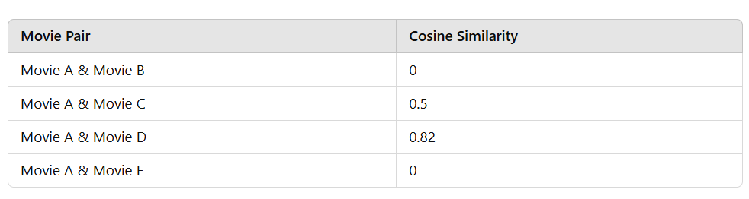
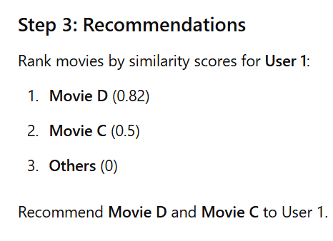

Slide 16
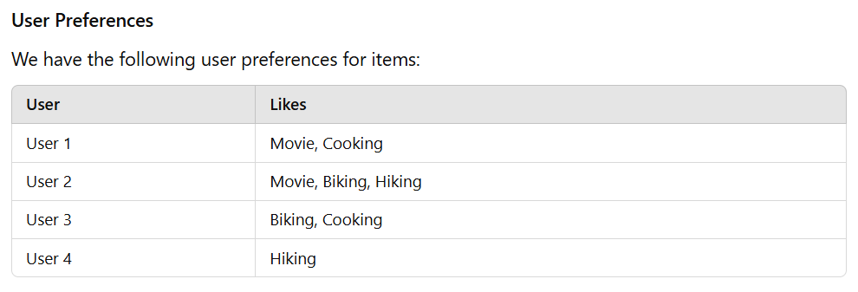
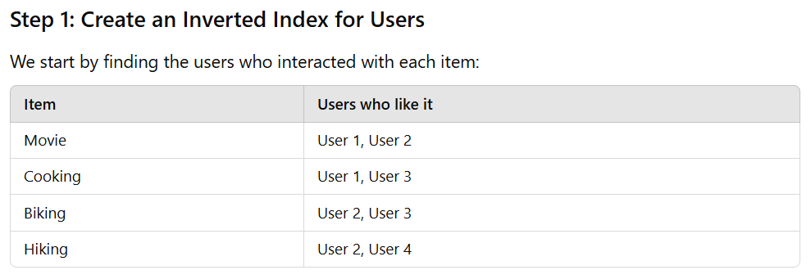
User-Based Collaborative Filtering

Slide 17
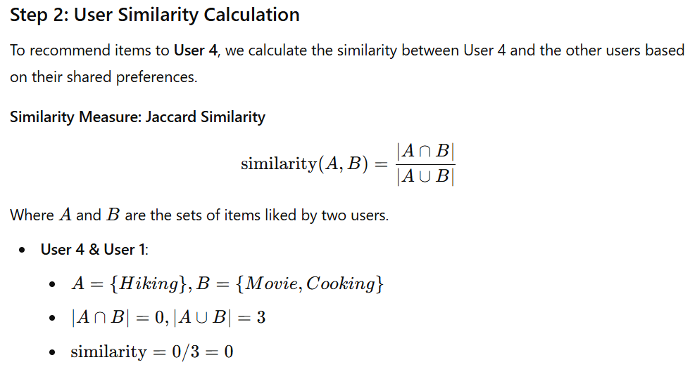
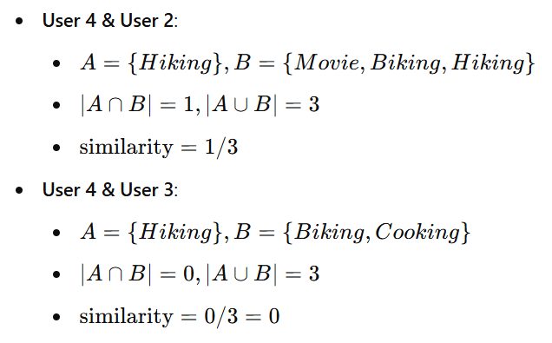

Slide 18
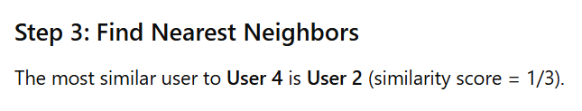
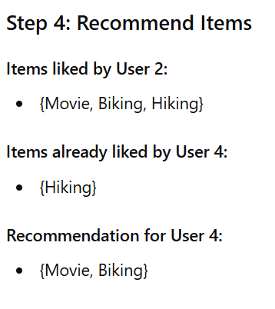
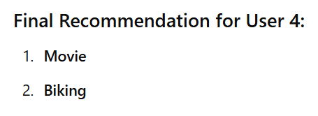

Slide 19
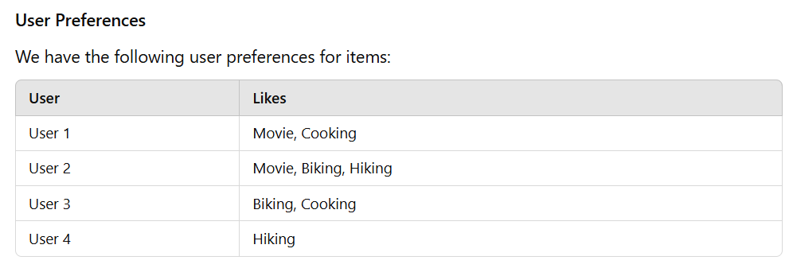
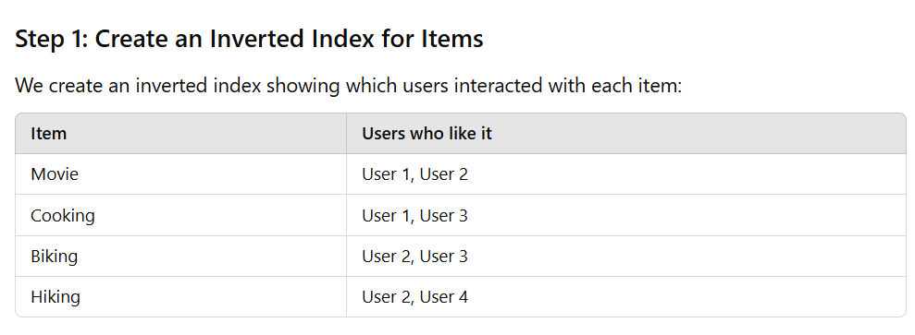
Item-Based Collaborative Filtering

Slide 20
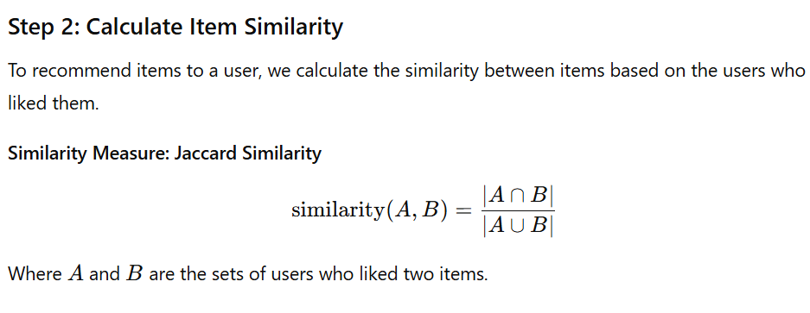
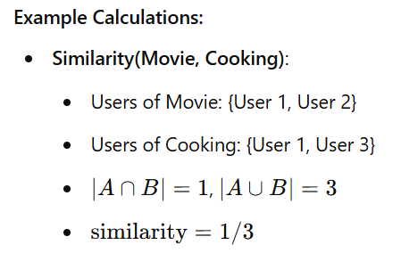

Slide 21
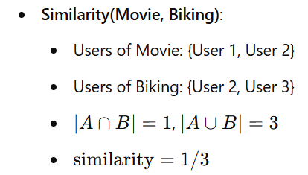
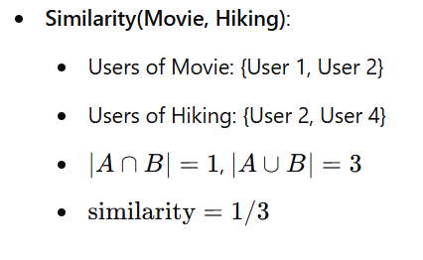
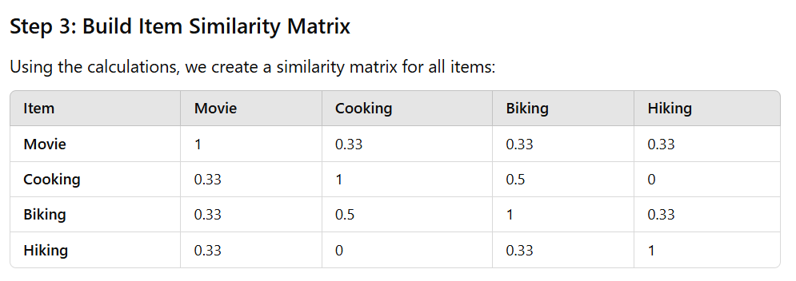

Slide 22
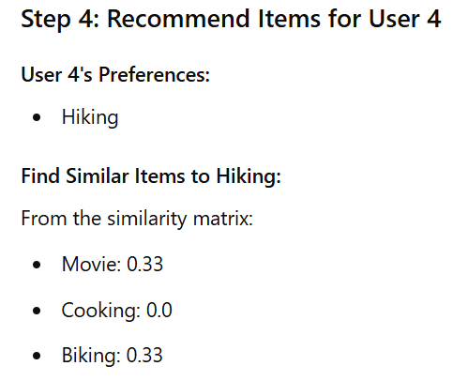
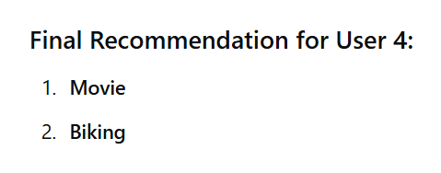
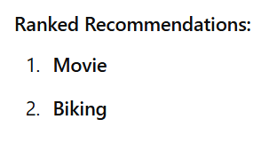

Slide 23
Applications of Recommendation Engines
E-commerce: Suggesting products (Amazon, eBay).
Streaming services: Recommending movies, shows, or music (Netflix, Spotify, YouTube).
News platforms: Showing articles based on user interests (Flipboard, Pocket).
Online learning: Suggesting courses or educational material (Coursera, Khan Academy).
Benefits of Recommendation Engines
Personalization: Creates tailored user experiences.
Increased engagement: Encourages users to spend more time on the platform.
Higher conversion rates: Boosts sales or subscriptions by suggesting relevant items.
Efficient exploration: Helps users discover content they might not find otherwise.

Slide 24
Clothes Recommendation system
User/Item | Jeans | Jacket | Hoodie | Sleeveless
User-1 | 2 | - | 6 | -
User-2 | 5 | 1 | 2 | -
User-3 | 3 | 4 | 1 | -
User-4 | - | 2 | 4 | 1
User-5 | - | - | 1 | 1

Slide 25
Key Functions of Recommendation Systems
Data Collection
Data Processing and Analysis
Prediction of Preferences
Recommendation Generation
Personalization
Filtering
Adaptation
Presentation

Slide 26
User Data Entry: The process begins with users entering their data, such as location and interests. This initial input is critical as it forms the foundation of the recommendation system.
Determining Comparison Parameters: The next step is to determine the parameters for comparison. These parameters could include factors like community size, activity level, and the relevance of topics to the user's interests.
Specifying User's Data Based on Parameters: Once the parameters are set, the system refines the user's data accordingly. This involves filtering and organizing the input data to match the comparison criteria.
Community Data Determination: The system then processes community data based on the refined user data. This step ensures that only the most relevant communities are considered for recommendations.
Iterative Parameter Refinement: If additional parameters are needed, the system revisits the comparison parameters and further refines the user's data. This iterative process continues until the system is ready to display the recommendations.
Displaying Recommendations: Finally, the system displays the recommended communities to the user. These recommendations are tailored to the user's location and interests, ensuring a personalized and engaging experience.

Slide 27
1. Recommendation Systems Functions
Data Collection
Data Processing and Analysis
Prediction of Preferences
Recommendation Generation
Personalization
Filtering
Adaptation
Presentation

Slide 28
1. Data Collection: The journey begins with collecting data from users. This data includes user preferences, behaviors, interactions, and feedback. It serves as the foundation for building effective recommendation models.
2. Data Processing and Analysis: Once collected, the data undergoes processing and analysis. This step involves cleaning, organizing, and transforming raw data into a structured format. Advanced analytical techniques are applied to extract meaningful patterns and insights.
3. Prediction of Preferences: With analyzed data, the system predicts user preferences. Machine learning algorithms are employed to identify trends and anticipate what users might like based on their past behavior and preferences.
4. Recommendation Generation: Using the predicted preferences, the system generates recommendations. These suggestions are tailored to individual users, aiming to provide content that aligns with their interests and needs.

Slide 29
5. Personalization: Personalization is key in a successful recommender system. The system adapts the recommendations to each user's unique profile, ensuring that the suggestions feel relevant and engaging.
6. Filtering: To improve accuracy, the system filters out irrelevant or less relevant content. This step ensures that users receive only the most prominent recommendations, enhancing their overall experience.
7. Adaptation: The system continuously adapts and refines its recommendations based on new data and user interactions. This iterative process helps in maintaining the relevance and effectiveness of the suggestions.
8. Presentation: Finally, the recommendations are presented to the user. The way suggestions are displayed can significantly impact user engagement, so it's essential to present them in a user-friendly and appealing manner.

Slide 30
Recommender Systems Function
A recommendation system's primary function is to analyze user behavior, preferences, and data to provide personalized suggestions for items, products, or content.
These systems aim to improve user experience and engagement by reducing the effort users need to find relevant content.
Key Functions of Recommendation Systems
Data Collection
Collects data from users, items, and interactions to understand preferences and behavior.
Types of data collected:
Explicit feedback: User ratings, likes, or reviews.
Implicit feedback: Browsing history, click-throughs, purchases, or time spent on content.

Slide 31
2. Data Processing and Analysis
Processes collected data to extract patterns and relationships
Uses techniques like:
Analyzing user-item interactions
Identifying similar items or users
3. Prediction of Preferences
Predicts what the user might like or be interested in based on historical data and current behavior.
Example: If a user listens to pop songs, the system predicts other pop songs they might enjoy.
4. Recommendation Generation
Generates a list of suggested items tailored to the user.
The suggestions can be ranked by relevance, popularity, or other metrics.

Slide 32
5. Personalization
Customizes recommendations for each user based on their unique preferences and history.
6. Filtering
Filters out irrelevant, inappropriate, or already-seen content to enhance relevance.
7. Adaptation
Continuously learns and updates recommendations based on new interactions and feedback.
Example: A user’s preferences for genres, styles, or topics can evolve over time.
8. Presentation
Displays recommendations in a way that encourages user engagement
Example: A carousel of "Recommended for You" on Netflix or Amazon

Slide 33
Examples Use Cases
Amazon: Recommends products based on past purchases, browsing history, and similar users.
Netflix: Suggests shows or movies using collaborative filtering and user viewing history.
Spotify: Creates playlists like "Discover Weekly" using music preferences and listening behavior.
YouTube: Recommends videos based on watch history and trending content.

Slide 34
2. Recommendation Techniques
Recommendation techniques are the methods or algorithms used by recommendation systems to suggest items or content to users. These techniques below is an overview of the main recommendation techniques:
Content-Based Filtering (CBF)
How it works: Recommends items similar to what a user has interacted with or liked based on item attributes
Core idea: Focuses on the similarity between items rather than user behavior
Example: If you watch a movie with the genre "sci-fi," the system recommends other sci-fi movies
Pros:
No need for user interaction data (works well for new users)
Highly personalized to the user
Cons:
Struggles with diversity (may suggest only similar items, leading to a "filter bubble")
Requires detailed and structured metadata about items
Algorithms used:
Cosine similarity TF-IDF (for text-based attributes) K-Nearest Neighbors (KNN)

Slide 35
2. Collaborative Filtering (CF)
Collaborative filtering focuses on the interaction between users and items.
User-User Collaborative Filtering
How it works: Finds similar users based on their preferences or behavior and recommends items that similar users liked.
Example: If user A and user B have similar purchase histories, items liked by user A may be recommended to user B
b) Item-Item Collaborative Filtering
How it works: Finds similar items based on user interactions and recommends items similar to what the user interacted with
Example: If you bought a camera, it might recommend accessories like tripods or memory cards
Pros:
No need for item attribute data
Good at finding patterns in large user bases

Slide 36
Cons:
Suffers from the cold start problem for new users or items
Computationally expensive for very large datasets
Algorithms used:
Matrix factorization (e.g., Singular Value Decomposition - SVD)
K-Nearest Neighbors (KNN)
Alternating Least Squares (ALS)

Slide 37
3. Hybrid Recommendation Systems
How it works: Combines content-based filtering and collaborative filtering techniques to improve performance
Example: Netflix combines collaborative filtering (user behavior) with content-based filtering (movie metadata)
Pros:
Mitigates the limitations of individual techniques (e.g., cold start, sparsity)
More accurate and diverse recommendations
Cons:
Increased complexity in implementation
Approaches:
Weighted hybrid: Combines scores from multiple models
Switching hybrid: Switches between techniques based on context or availability of data

Slide 38
4. Knowledge-Based Recommendation
How it works: Uses domain-specific knowledge and rules to recommend items based on user requirements or constraints
Example: Travel websites suggest destinations based on user inputs like budget, preferred climate, or activities
Pros:
Works well when user preferences are explicit
No reliance on historical data
Cons:
Requires predefined knowledge and rules
Less flexible in adapting to evolving user behavior

Slide 39
5. Context-Aware Recommendations
How it works: Incorporates contextual information (e.g., time, location, weather, device) to generate recommendations.
Example: A food delivery app recommends breakfast items in the morning or nearby restaurants when traveling.
Pros:
More relevant recommendations based on the user’s situation.
Adds depth to user-item interaction modeling.
Cons:
Requires access to context data, which can raise privacy concerns.
Increased complexity in modeling.

Slide 40
6. Deep Learning-Based Recommendations
How it works: Uses neural networks to model complex relationships in user-item interactions
Example: YouTube uses deep learning to recommend videos by analyzing user behavior patterns
Techniques:
Neural Collaborative Filtering (NCF): Combines collaborative filtering with neural networks
Recurrent Neural Networks (RNNs): For sequence-aware recommendations(e.g., music playlists)
Convolutional Neural Networks (CNNs): For image-based recommendations(e.g., fashion or design)
Pros:
Can handle highly complex datasets and relationships
Highly scalable and adaptable
Cons:
Requires significant computational resources
Needs large amounts of training data

Slide 41
7. Popularity-Based Recommendations
How it works: Recommends the most popular or trending items
Example: Suggesting best-sellers on Amazon or trending videos on YouTube
Pros:
Simple and easy to implement
No need for user interaction data
Cons:
No personalization
May not be effective for niche users

Slide 42
8. Association Rule Mining
How it works: Uses rules derived from data to recommend items frequently purchased or used together
Example: Market basket analysis suggests "Customers who bought bread also bought butter"
Pros:
Works well for cross-selling or bundling
Simple to understand and interpret
Cons:
Doesn’t account for user preferences
May not adapt to changing trends

Slide 43
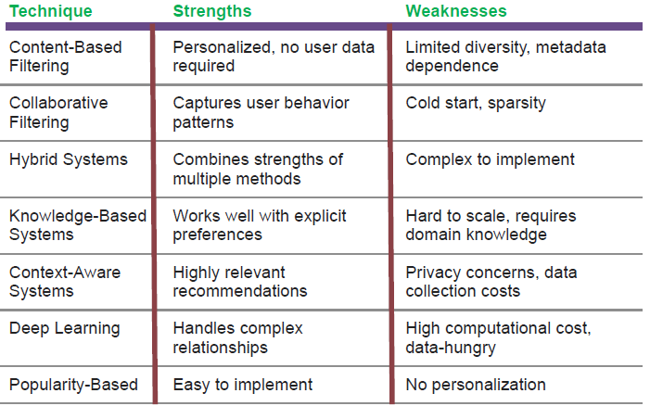
Summary of Techniques

Slide 44
3. Recommender Systems as a Multi-Disciplinary Field
Recommender systems are a multidisciplinary field that integrates knowledge, techniques, and concepts from various domains. These systems require expertise from multiple disciplines to effectively model, process, and deliver personalized recommendations. Here's an overview of the key fields that contribute to the development and functioning of recommender systems:
Computer Science and Engineering
Role: Provides the foundational knowledge and tools for designing, implementing, and optimizing recommender systems.
Key Contributions:
Algorithms and Data Structures: Efficient algorithms for searching, sorting, and ranking recommendations (e.g., matrix factorization, clustering).
Software Development: Building scalable and robust recommendation systems.
Big Data Processing: Handling massive datasets using distributed systems (e.g., Apache Spark, Hadoop).

Slide 45
2. Machine Learning and Artificial Intelligence (AI)
Role: Powers the prediction and personalization capabilities of recommender systems
Key Contributions:
Supervised and Unsupervised Learning: Techniques like classification, clustering, and reinforcement learning
Deep Learning: Neural networks for sophisticated recommendation tasks(e.g., Netflix's deep learning-based recommendation model)
Model Optimization: Training algorithms to improve accuracy and scalability (e.g., collaborative filtering, content-based models)
Example Techniques:
Gradient boosting methods like XGBoost
Neural Collaborative Filtering (NCF)

Slide 46
3. Mathematics and Statistics
Role: Provides the theoretical foundation for modeling relationships, analyzing data, and making predictions
Key Contributions:
Linear Algebra: Matrix factorization methods (e.g., Singular Value Decomposition) for collaborative filtering.
Probability and Statistics: Bayesian models, probability distributions, and hypothesis testing.
Optimization: Solving complex problems for model tuning (e.g., gradient descent).
4. Information Retrieval (IR)
Role: Focuses on retrieving relevant items from large datasets
Key Contributions:
Ranking: Developing ranking algorithms (e.g., PageRank, BM25) to prioritize items
Similarity Metrics: Methods for measuring item-user and item-item similarity (e.g., cosine similarity, Jaccard index)
Relevance Feedback: Learning from user interactions to improve future recommendations

Slide 47
5. Cognitive Science and Psychology
Role: Helps understand human decision-making, preferences, and behaviors,
which influence how recommendations are designed and presented.
Key Contributions:
Behavioral Models: Studying how users interact with and perceive recommendations.
Decision Theory: Understanding trade-offs, biases, and decision-making processes.
User Satisfaction: Designing systems to increase user trust and engagement.
6. Human-Computer Interaction (HCI)
Role: Focuses on designing user-friendly interfaces and improving user experience (UX).
Key Contributions:
Interface Design: Creating intuitive layouts for displaying recommendations (e.g., recommendation carousels).
Feedback Mechanisms: Allowing users to provide feedback (e.g., thumbs up/down, ratings) to refine recommendations.
Explainability: Making recommendations transparent and understandable for users.

Slide 48
7. Data Science
Role: Enables the collection, cleaning, and analysis of large-scale user and item data
Key Contributions:
Data Preprocessing: Cleaning, normalizing, and transforming data for modeling
Feature Engineering: Extracting meaningful features from raw data
Analytics: Evaluating system performance using metrics like precision, recall, and RMSE
8. Economics and Game Theory
Role: Helps in understanding incentives, market dynamics, and strategic behavior
Key Contributions:
Personalization Trade-offs: Balancing between revenue (e.g., promoting sponsored items) and user satisfaction
Game Theory Models: Analyzing user interactions with the system, such as in auctions or competition
Pricing Optimization: Suggesting items with optimal pricing strategies

Slide 49
9. Ethics and Privacy
Role: Ensures that recommender systems are fair, ethical, and protect user data
Key Contributions:
Fairness: Avoiding biases in recommendations (e.g., gender, race)
Privacy: Implementing secure data practices (e.g., federated learning, differential privacy)
Transparency and Accountability: Explaining how recommendations are generated to build trust
10. Marketing and Consumer Behavior
Role: Helps align recommendations with business goals and customer needs
Key Contributions:
Segmentation: Understanding different customer groups to tailor recommendations
Engagement Strategies: Designing recommendations to maximize clicks, purchases, or user retention
Cross-Selling and Upselling: Suggesting complementary or higher-value products

Slide 50
11. Natural Language Processing (NLP)
Role: Useful for processing textual data like reviews, descriptions, and queries in recommendation systems.
Key Contributions:
Text Embedding: Transforming textual data into numerical formats for analysis (e.g., Word2Vec, BERT).
Sentiment Analysis: Understanding user sentiment from reviews to refine recommendations.
Conversational Recommenders: Chat bots that provide personalized suggestions through dialogue.

Slide 51
Multidisciplinary Synergy in Action
Here’s an example that shows how these disciplines work together in a recommender system:
Netflix's Recommender System:
Computer Science: Handles massive datasets with distributed systems.
Machine Learning: Uses collaborative and content-based filtering to predict user preferences.
Human-Computer Interaction: Designs the user-friendly interface for "Recommended for You."
Statistics: Evaluates recommendation accuracy with metrics like RMSE.
Ethics: Ensures the algorithm doesn’t promote harmful content.
NLP: Analyzes subtitles or user reviews for better recommendations.
By leveraging these multidisciplinary insights, recommender systems evolve into more accurate, scalable, and user-friendly tools, meeting the diverse needs of industries and users. Would you like further details on any specific discipline's role or an example system?

Slide 52
4. Challenges of Recommendation Systems
Recommender systems face a variety of challenges that stem from the complexity of user behavior, the diversity of data, and the need for scalability and fairness. Below are the key challenges grouped into various categories:
1. Data Challenges
Cold Start Problem
Definition: Difficulty in making recommendations for:
New Users: No prior interaction or history available to base recommendations on.
New Items: Items that lack sufficient interaction data.
Example: Recommending books to a first-time user or a new book added to a platform.

Slide 53
c) Data Quality
Definition: Recommender systems require clean, complete, and accurate data. Noisy, missing, or inconsistent data reduces performance
Example: Misleading ratings or fake reviews can distort recommendations
d) Scalability
Definition: Systems need to handle massive datasets with millions of users and items
Example: Computing recommendations for Amazon's catalog with billions of products requires efficient algorithms and distributed systems

Slide 54
2. Algorithmic Challenges
Balancing Accuracy and Diversity
Definition: While accuracy aims to predict user preferences, diversity ensures users are exposed to a variety of items
Example: A movie recommendation system might repeatedly suggest similar movies (e.g., sci-fi) but fail to expose users to different genres (e.g., drama, comedy)
b) Overfitting
Definition: Recommendation models may perform well on training data but fail to generalize to unseen data
Example: A content-based system might over-focus on specific features and recommend overly niche items
c) Real-Time Recommendations
Definition: Generating recommendations dynamically in response to user actions (e.g., streaming services or online shopping) is computationally expensive
Example: Recommending products instantly as users add items to their cart

Slide 55
d) Explainability
Definition: Many recommendation algorithms (e.g., deep learning) are black-box models, making it hard to explain why an item was recommended
Example: Users often trust recommendations more if the system provides an explanation like, "You liked X, so we suggest Y"
3. User-Related Challenges
Dynamic Preferences
Definition: User preferences change over time, requiring systems to adapt
Example: A user might prefer romance movies during one month and thrillers the next
b) User Engagement
Definition: Recommender systems need user feedback (explicit or implicit) to improve, but users may not provide enough interactions
Example: Users often skip rating items or providing direct feedback

Slide 56
c) Filter Bubbles
Definition: Recommenders may reinforce existing preferences and isolate users from diverse or novel content
Example: A user who listens only to pop music on Spotify might never discover other genres like jazz or classical
d) Trust and Transparency
Definition: Users may not trust recommendations if they suspect bias (e.g., promoting sponsored items)
Example: A system that pushes only paid content can lead to user dissatisfaction
4. Ethical and Social Challenges
Bias in Recommendations
Definition: Algorithms can inherit biases present in the data, leading to unfair or discriminatory recommendations
Example: Job recommendation systems might unintentionally prioritize male candidates for certain roles if the training data is biased

Slide 57
b) Privacy Concerns
Definition: Recommenders require user data (e.g., location, browsing history),raising privacy issues
Example: Users may hesitate to share personal information for fear of misuse
c) Manipulation and Fraud
Definition: Systems can be manipulated by malicious actors (e.g., fake reviews, bot activity)
Example: Businesses might generate fake positive reviews for their products to appear at the top of recommendations
5. Domain-Specific Challenges
Context-Awareness
Definition: Recommender systems often fail to account for contextual factors(e.g., time, location, device)
Example: A food delivery app recommending dinner dishes during breakfast hours

Slide 58
b) Multi-Objective Optimization
Definition: Balancing multiple objectives, such as relevance, profitability, and user satisfaction, is complex
Example: An e-commerce platform may need to recommend profitable items without compromising on user preferences
c) Long-Tail Recommendations
Definition: Most items in a catalog receive little attention, but promoting such items can improve user experience and business goals
Example: Suggesting lesser-known books on a reading platform like Goodreads
d) Cold Start in Specialized Domains
Definition: Certain domains (e.g., healthcare or education) require highly personalized recommendations with limited data
Example: Recommending medical treatments requires precise and sensitive data, which is often limited

Slide 59
6. Evaluation Challenges
Defining Success Metrics
Definition: Selecting appropriate metrics to evaluate recommender systems is challenging
Common Metrics:
Accuracy-based (e.g., Precision, Recall, RMSE)
Engagement-based (e.g., Click-Through Rate, Conversion Rate)
Diversity and Novelty (e.g., Serendipity Score)
b) Offline vs. Online Evaluation
Definition:
Offline evaluation uses historical data to test models, but it doesn’t capture real-world user behavior.
Online evaluation (e.g., A/B testing) is more realistic but expensive and time-consuming.
Example: A recommender system might perform well in a lab setting but fail to engage users in practice.

Slide 60
7. Scalability and Infrastructure Challenges
Large-Scale Data Handling
Definition: Modern recommendation systems deal with millions of users and billions of items, requiring robust infrastructure
Example: Netflix processes vast amounts of data daily to keep recommendations updated
b) Latency
Definition: Delivering real-time recommendations with minimal delay is crucial for user experience
Example: Generating recommendations instantly as users browse items on Amazon

Slide 61
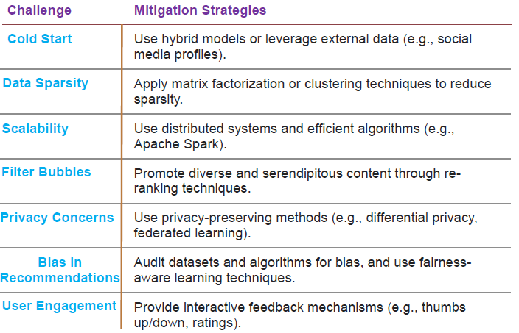
Summary of Challenges and Mitigation Strategies

